Slide 1
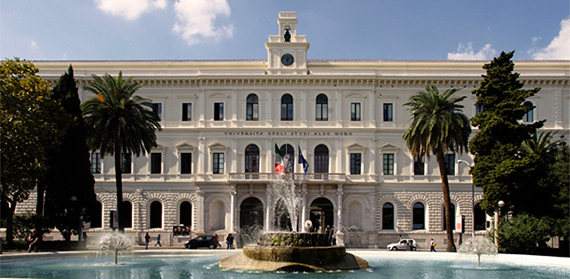
Le crisi demografiche, economiche, giuridico-politiche e sociali nell'epoca contemporanea

Slide 2
National and international challenges in Europe and beyond:
a linguistic analysis

Slide 3
Denise Milizia
English Language and Translation (L-LIN/12)
denise.milizia@uniba.it
www.denisemilizia.com
Ateneo

Slide 4
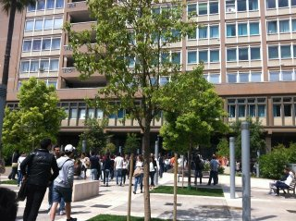
Department of Political Science
Piazza Cesare Battisti

Slide 5
Department of Political Science
Corso Italia 23
4th floor
Room 28
Tel. +39.080.5717849

Slide 6
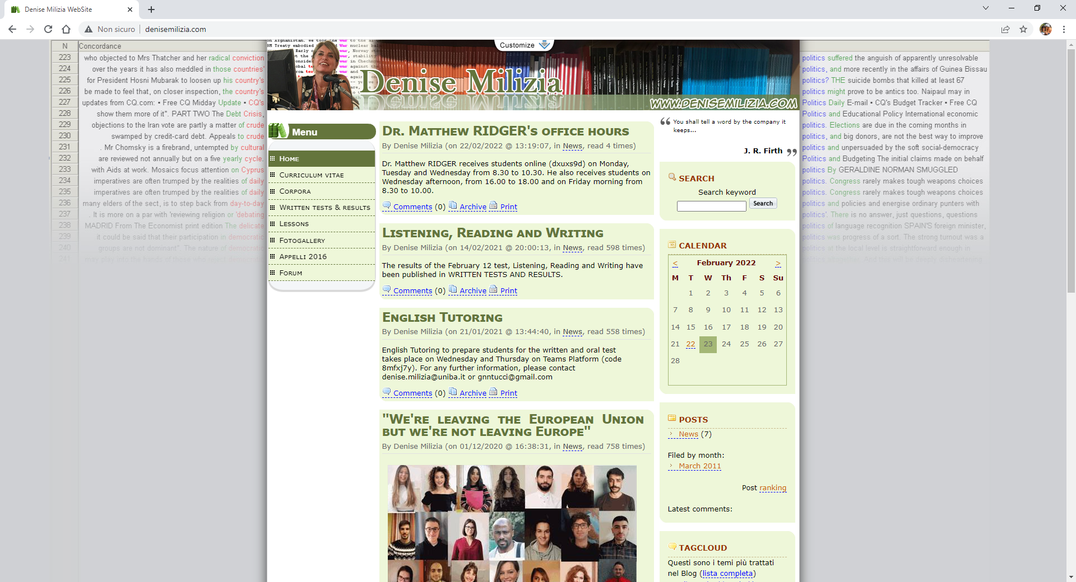
www.denisemilizia.com

Slide 7
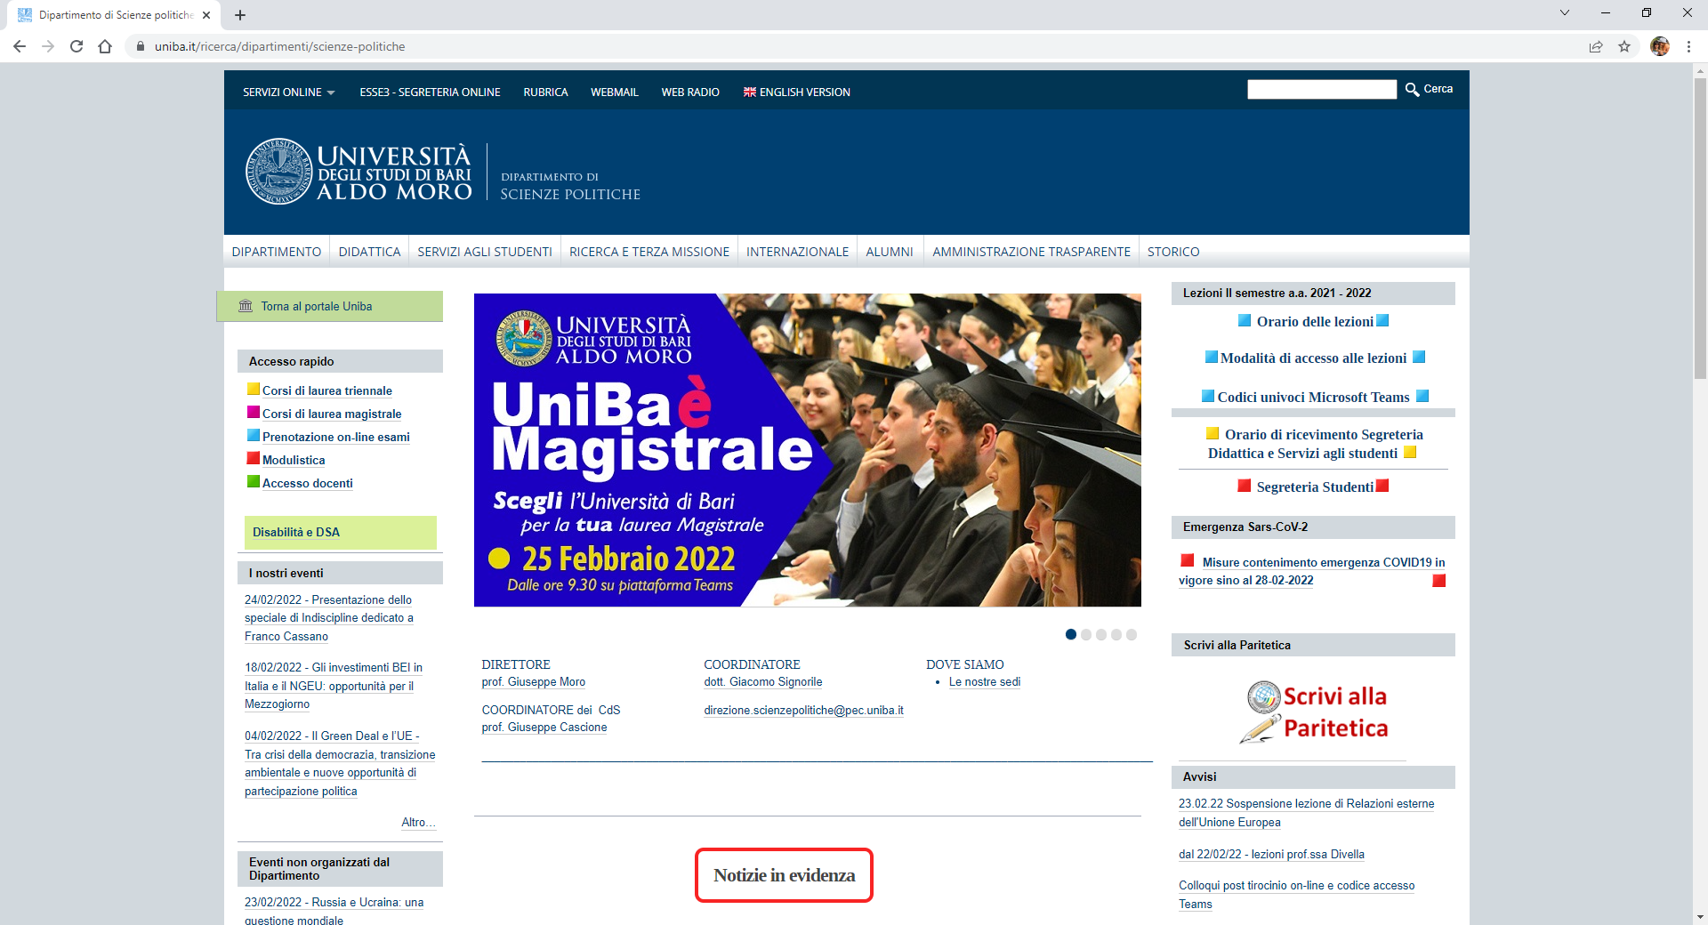

Slide 8
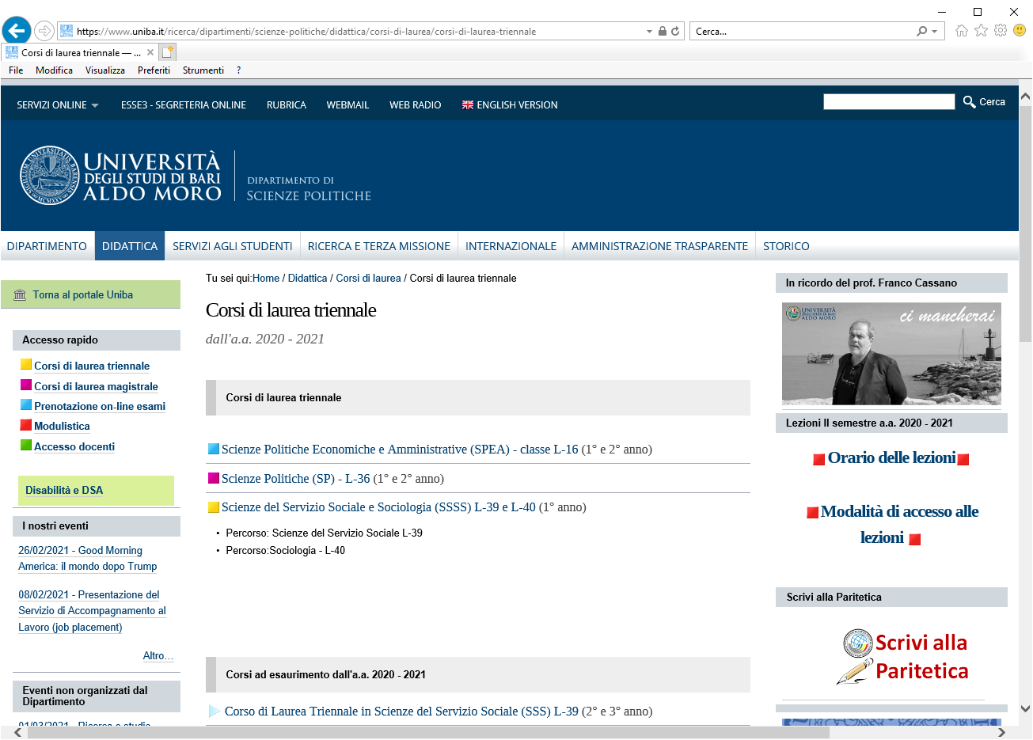
?

Slide 9
B.A.

Slide 10
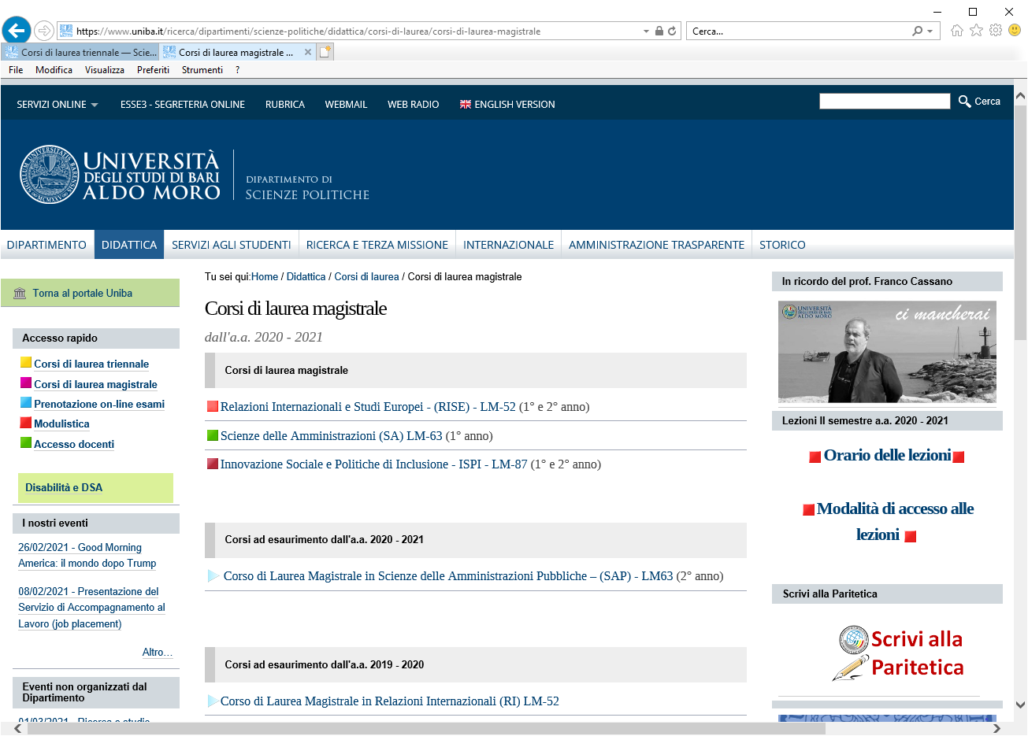
?

Slide 11
M.A.

Slide 12
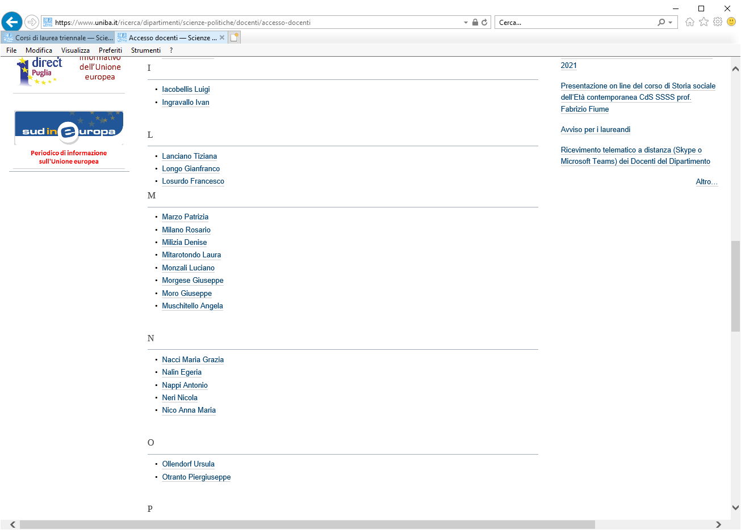

Slide 13
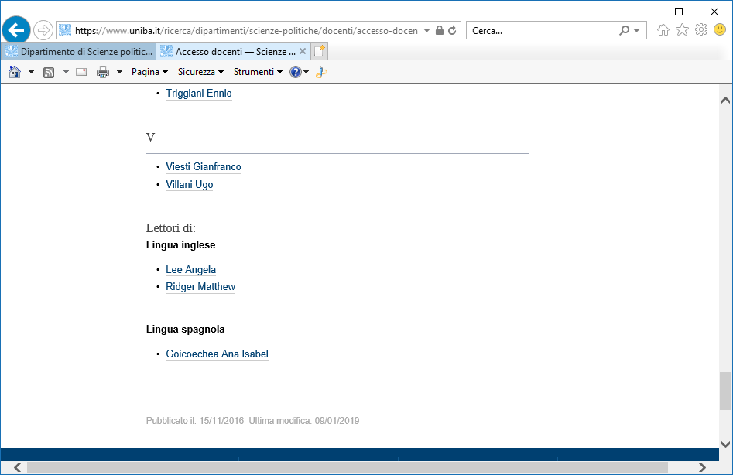

Slide 14
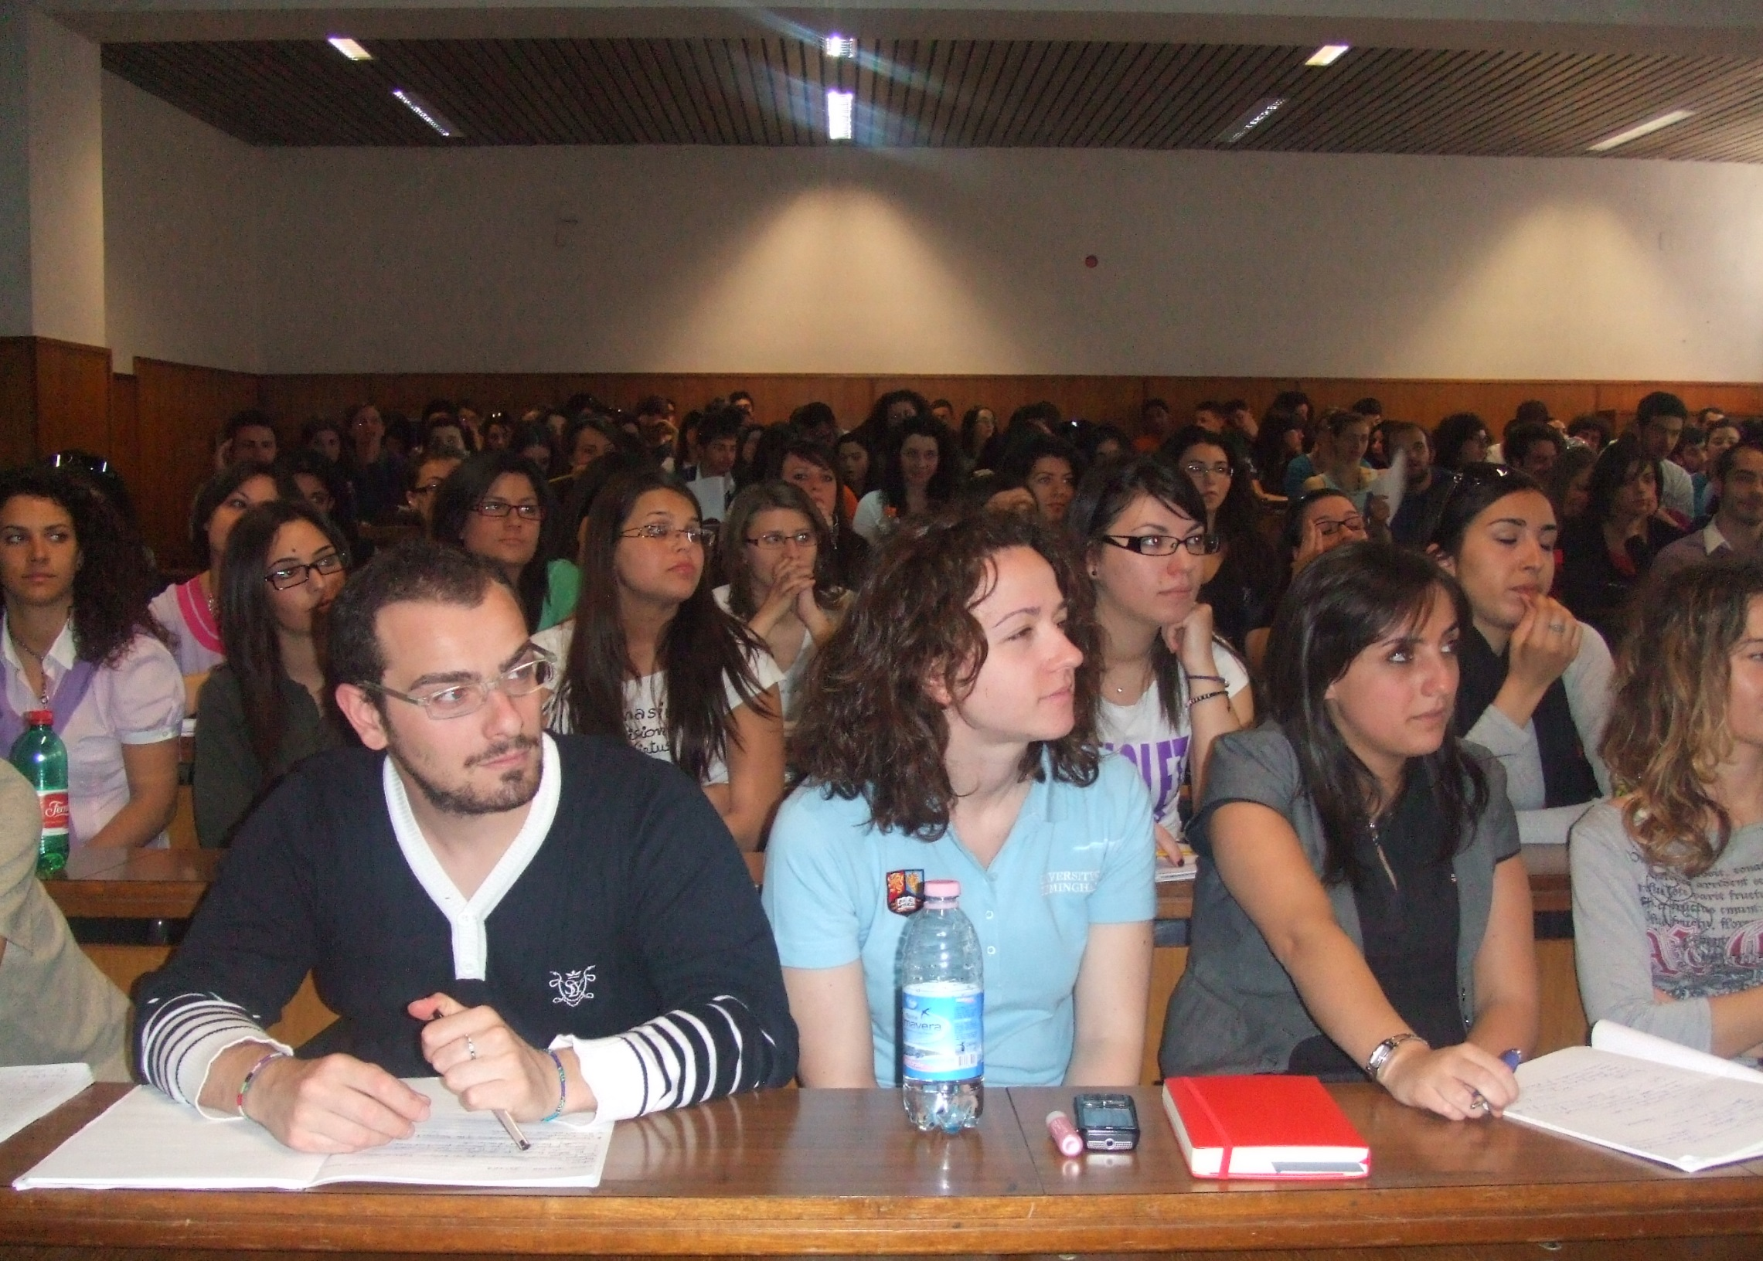
SPEA - L16
SP - L36
2nd year
8 CFU
64 hours

Slide 15
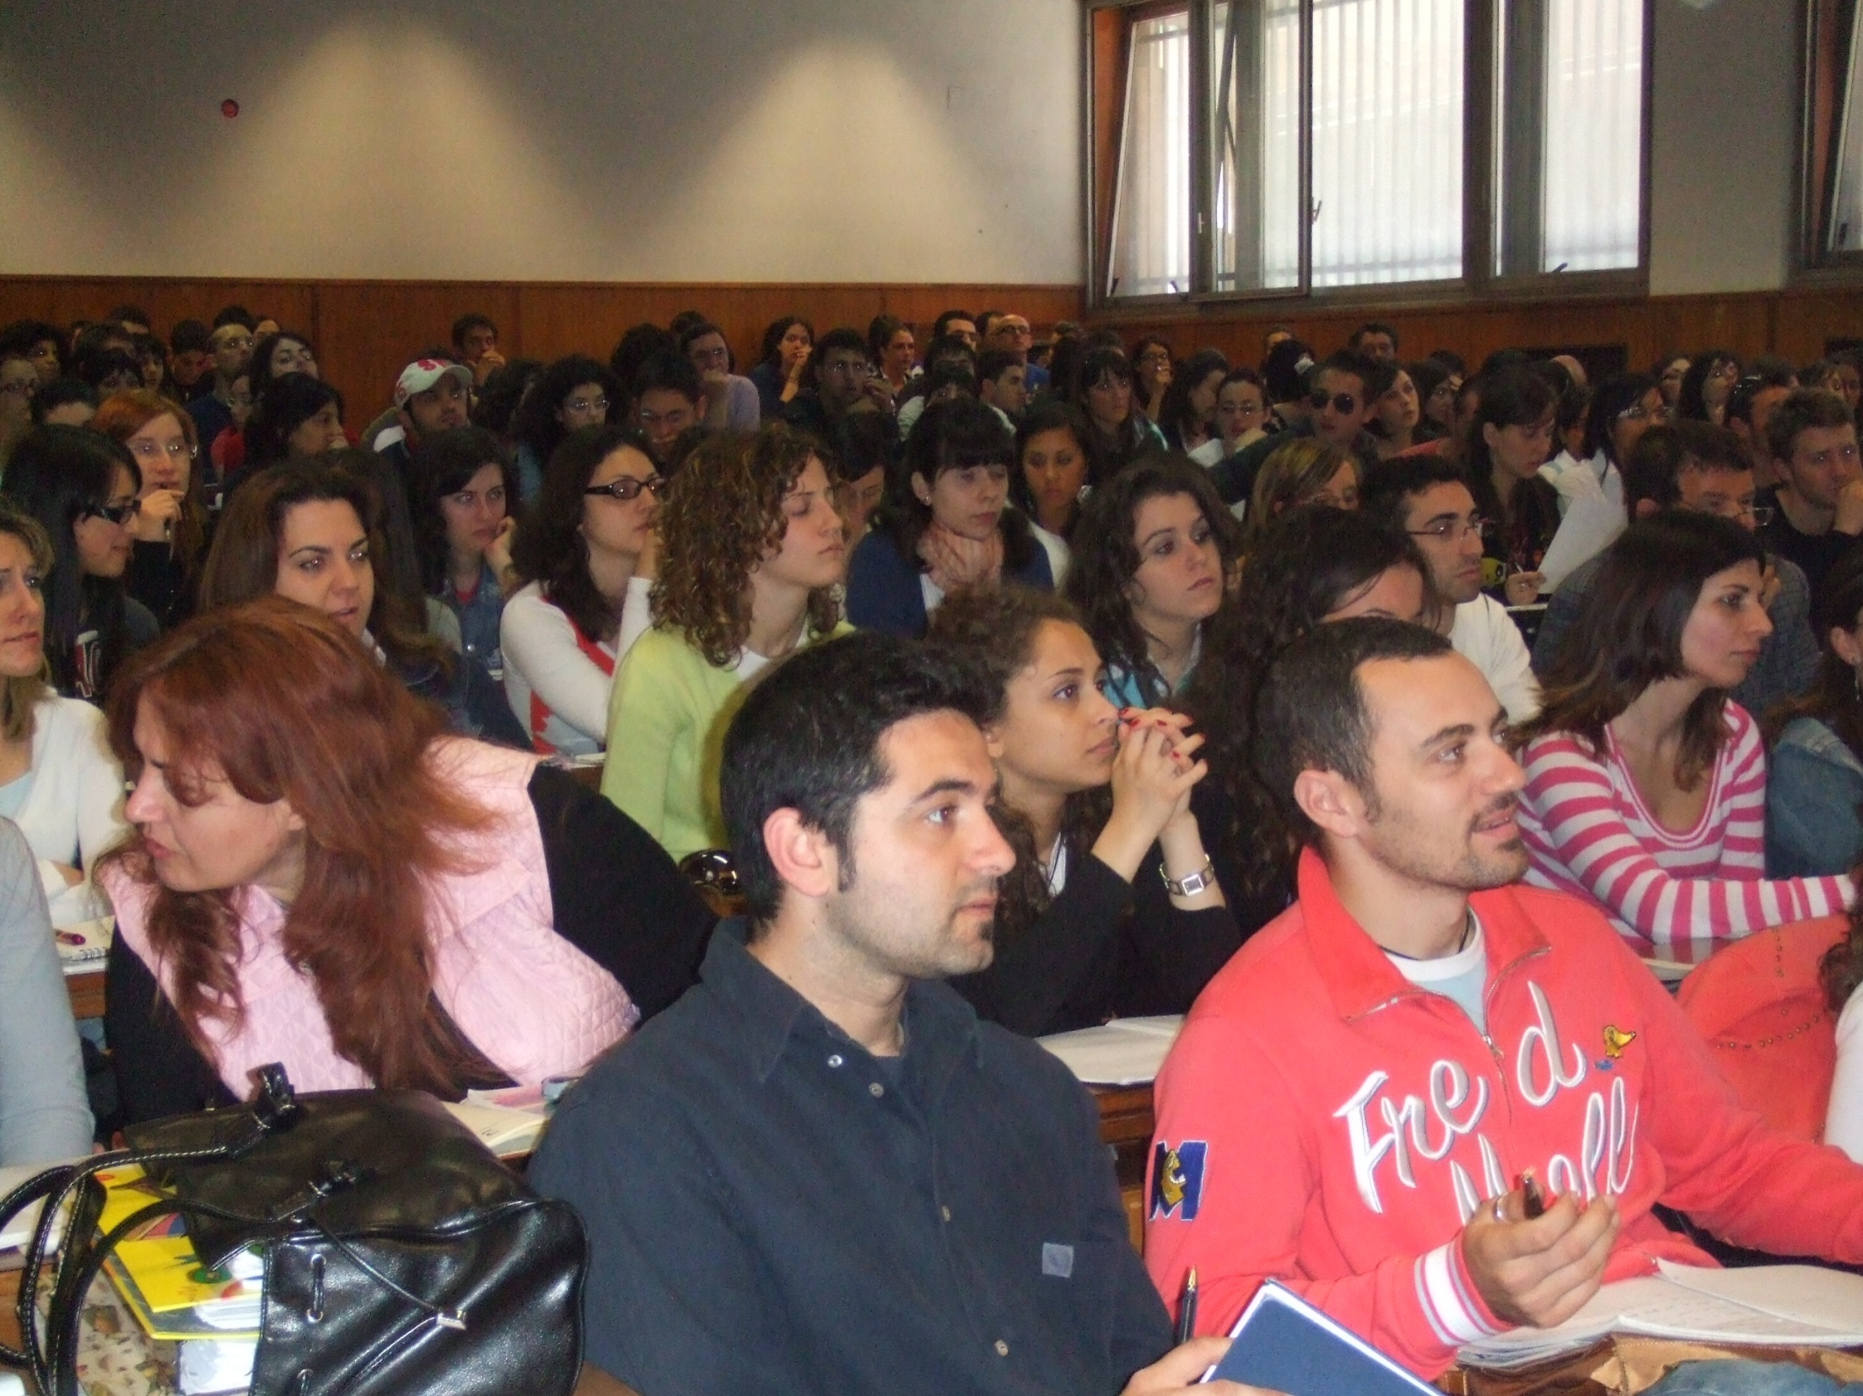
SSSS - L39 - L40
2nd year
7 CFU
56 hours

Slide 16
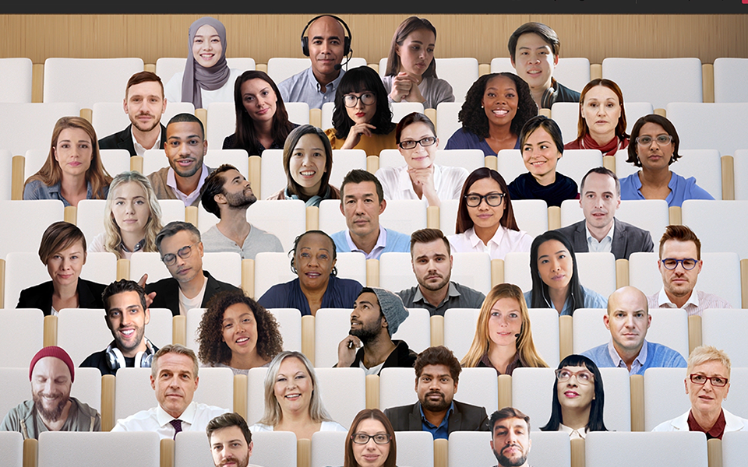
March 2020
March 2022

Slide 17
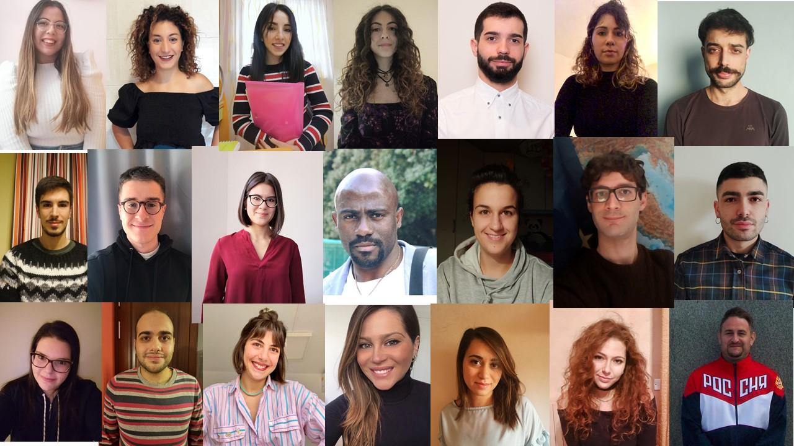
We are leaving the European Union but we’re not leaving Europe
M.A. students majoring in International Relations and European Law:
the cake and cherry approach to the EU.

Slide 18
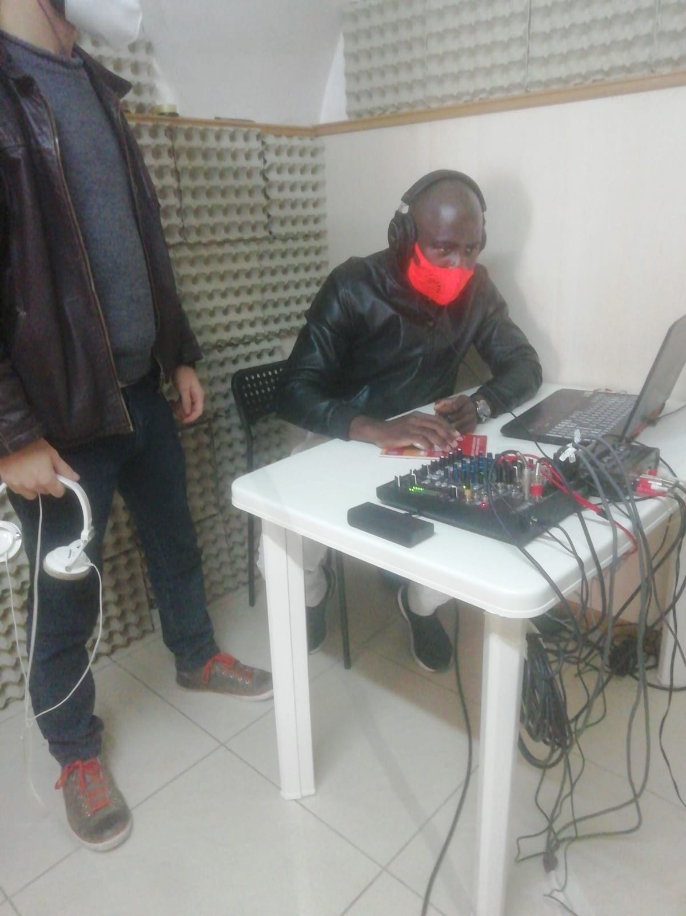
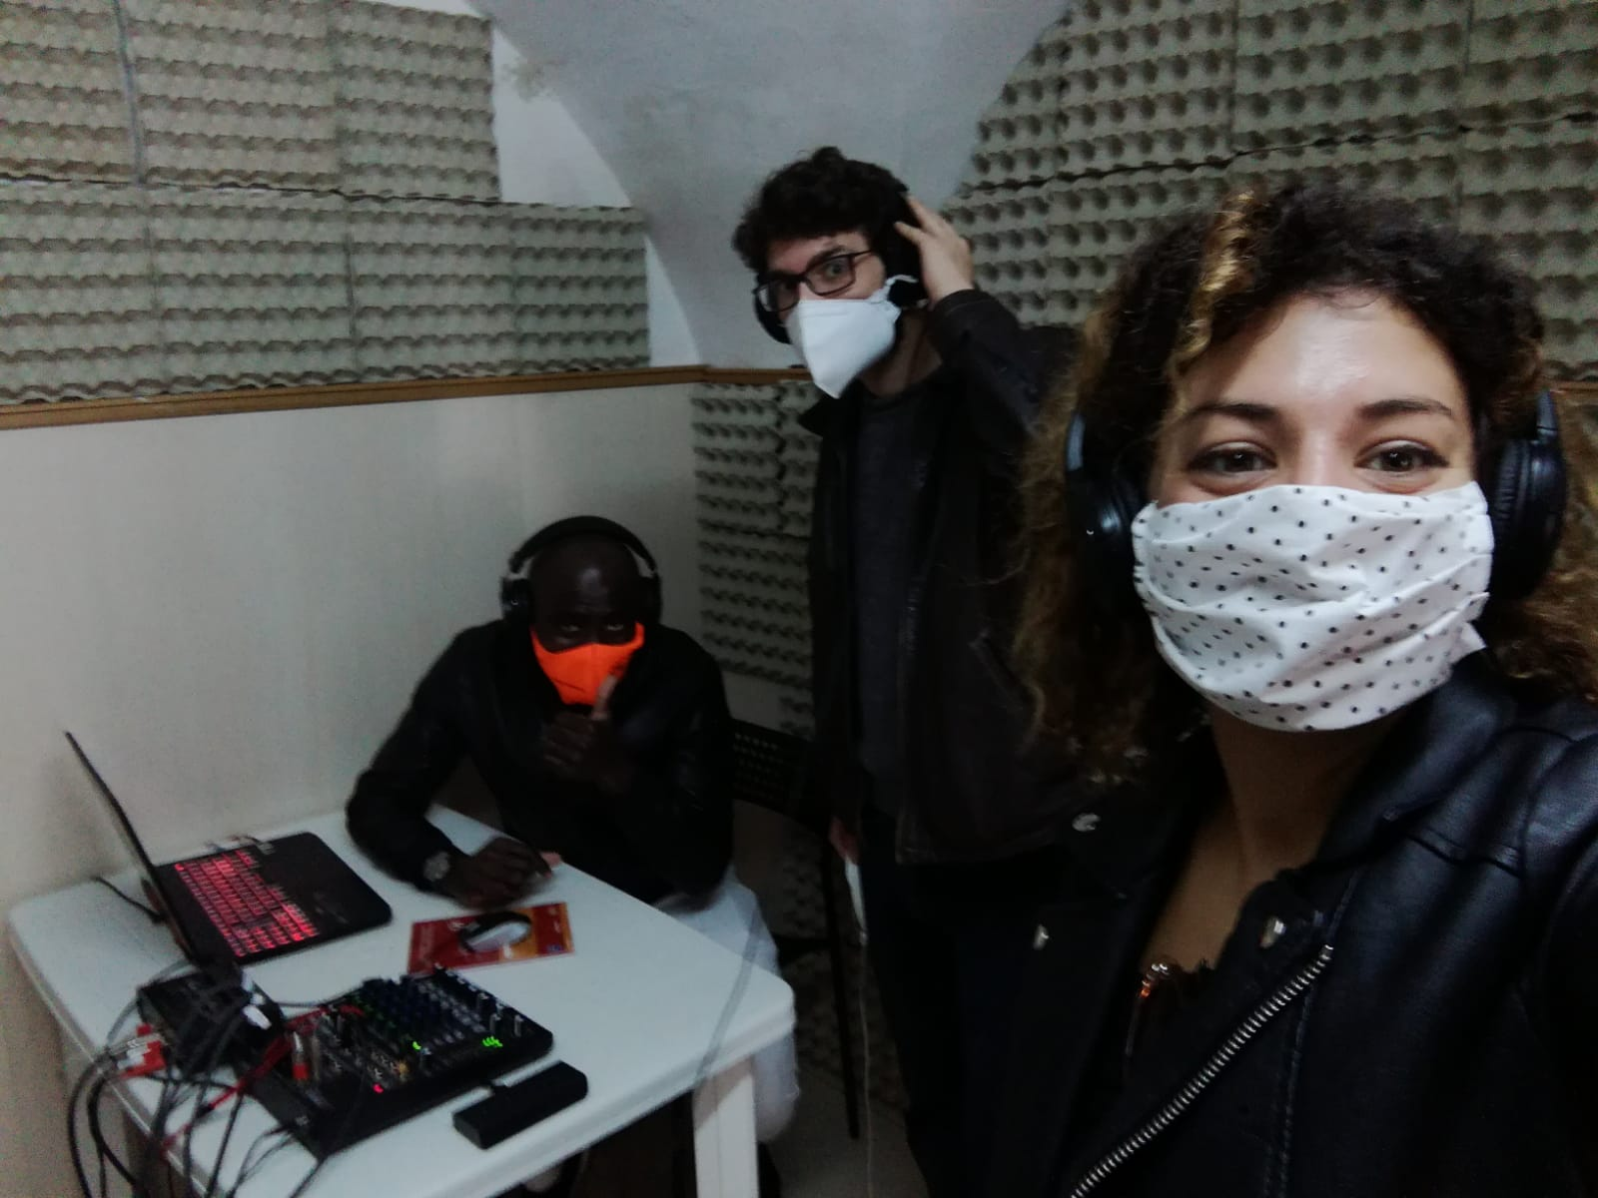
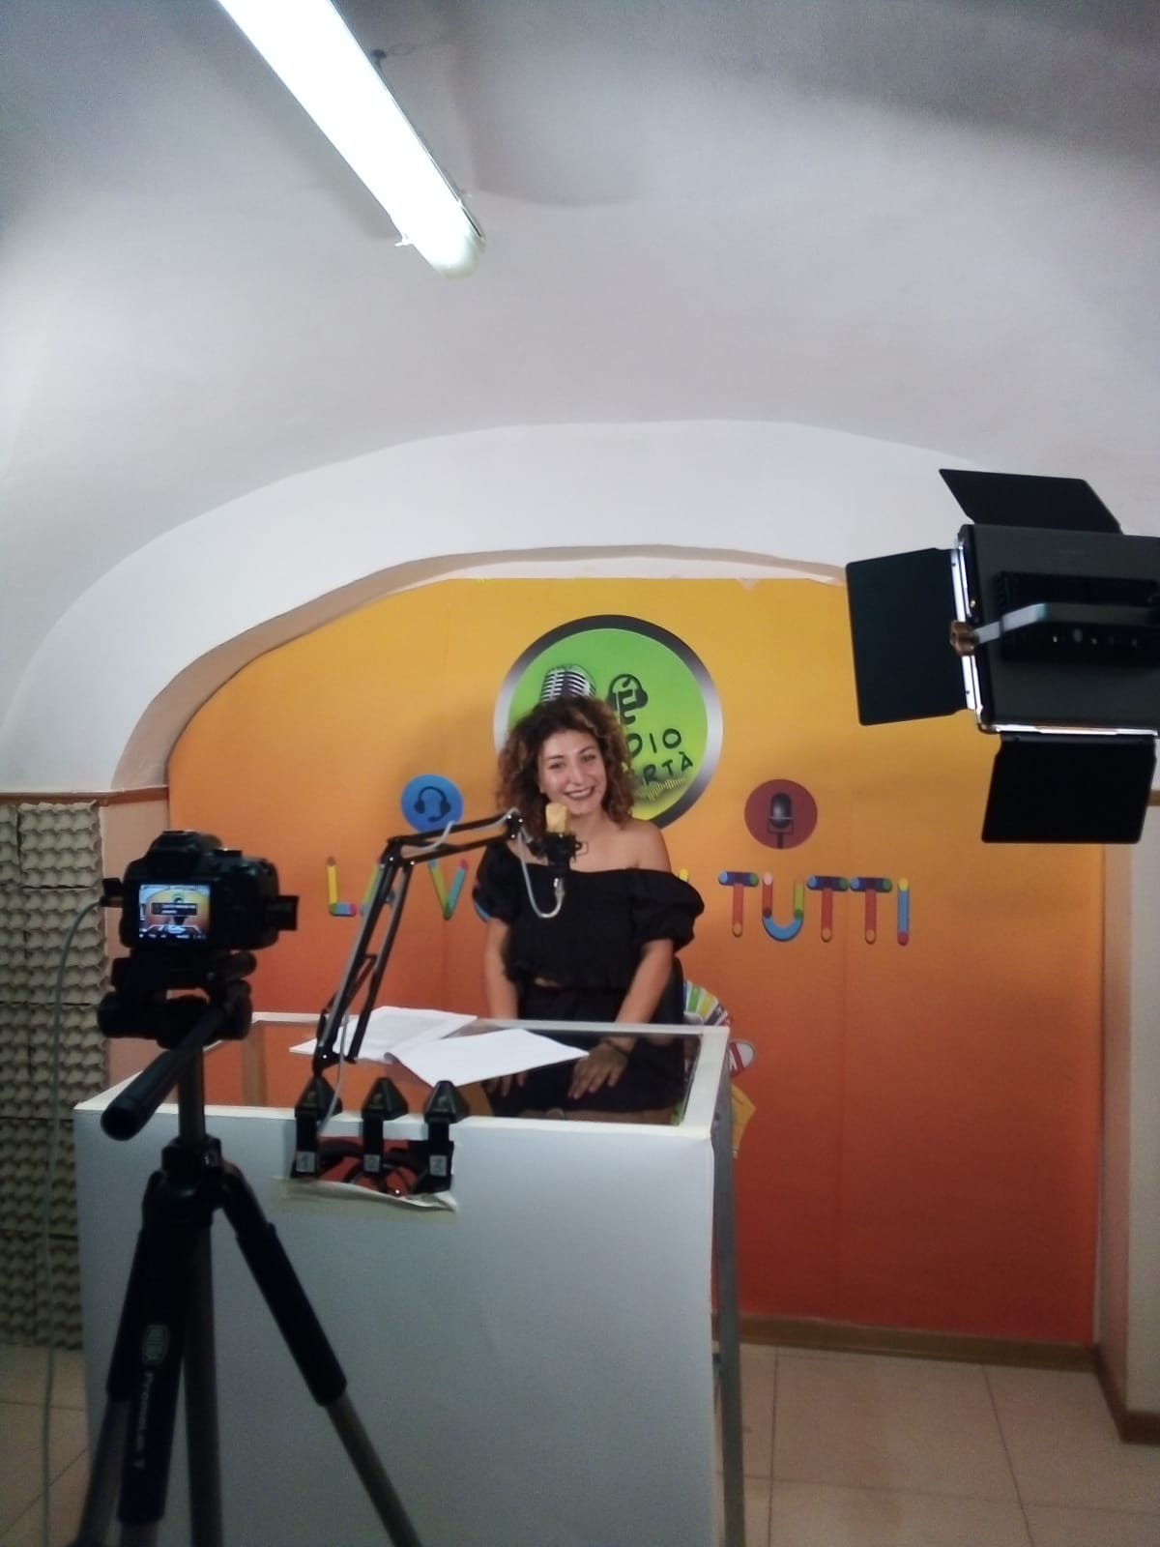
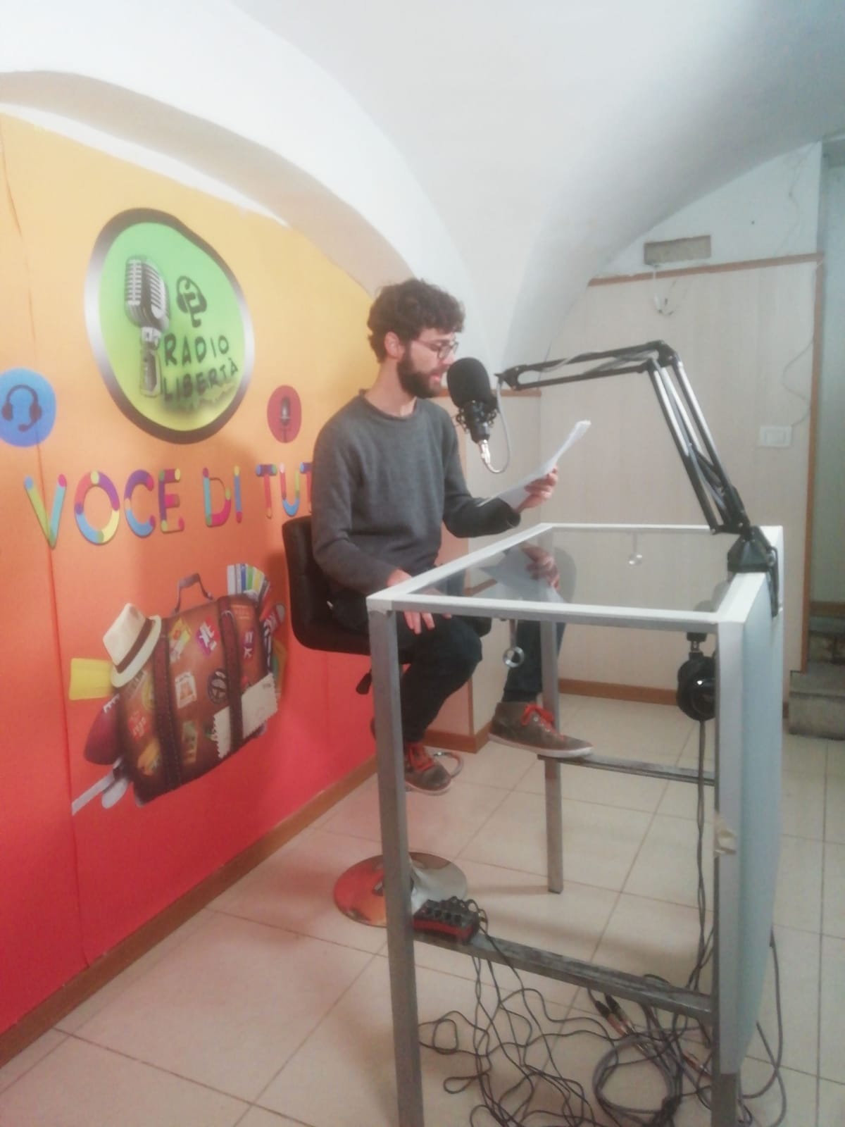
We are leaving
the European Union but
we’re not leaving Europe:
the cake and cherry approach
to the EU.
M.A. students
in the Recording Studio

Slide 19
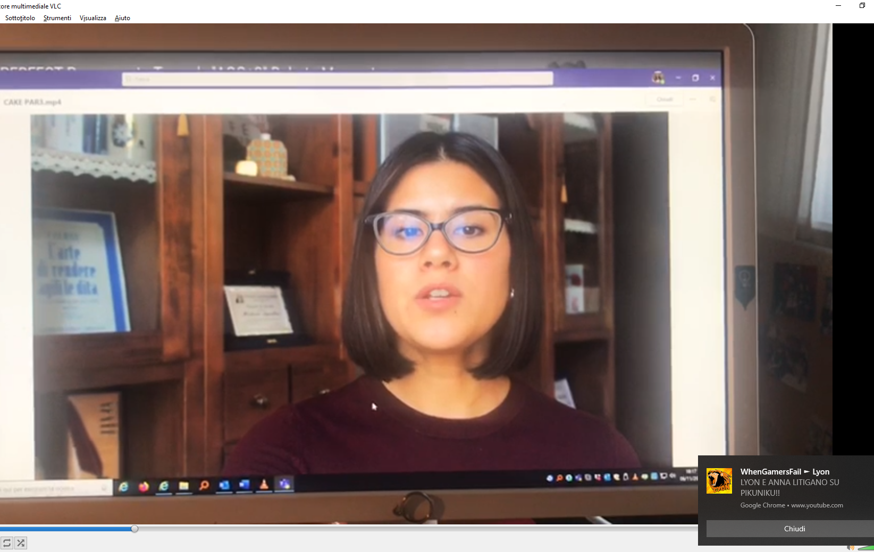

Slide 20
March 2020
March 2021
So……
We talk, talk, and talk, we talk a lot.
And ……
We listen, listen, and listen, we listen a lot.

Slide 21
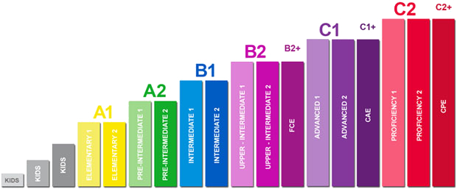
Common European Framework of Reference for Languages

Slide 22
Common European Framework of Reference for Languages

Slide 23
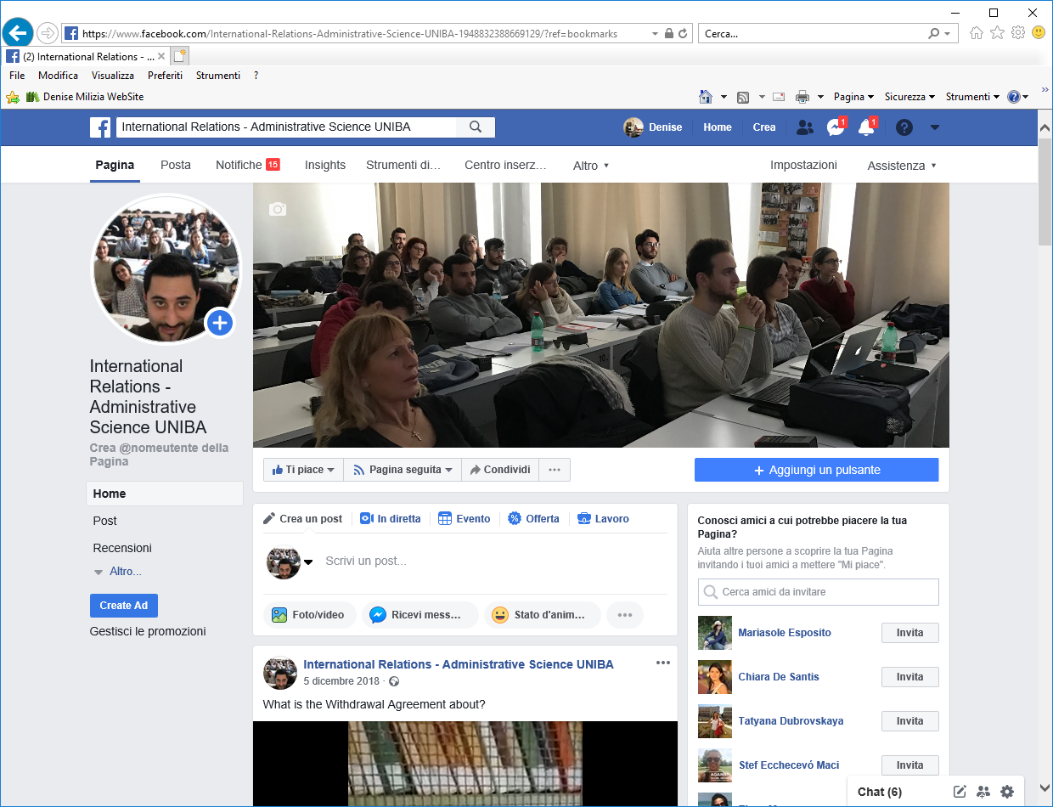

Slide 24
Attendance

Slide 25
Attendance
Highly recommended

Slide 26
exam
1. written test

Slide 27
exam
1st mid-term test
1. written test
2nd mid-term test
3rd mid-term test

Slide 28
exam
1st mid-term test
1. written test
2nd mid-term test
3rd mid-term test
2. oral test

Slide 29
What do we do?
How do we do it?

Slide 30
We study grammar, lexis and
phrases through the
language of politicians.
Examples taken from
real life language use!

Slide 31
We study grammar, lexis and
phrases through the
language of politicians.
Examples taken from
real life language use!

Slide 32
We study the language of
politics through the language
of politicians.
POLITICAL CORPUS
Examples taken from
real life language use!

Slide 33
What is a CORPUS ?
POLITICAL CORPUS
A CORPUS is a collection of texts that
we can process automatically.

Slide 34
What is a CORPUS ?
POLITICAL CORPUS
WRITTEN
SPOKEN

Slide 35
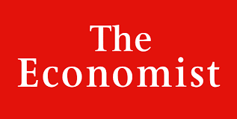
WRITTEN
SPOKEN

Slide 36
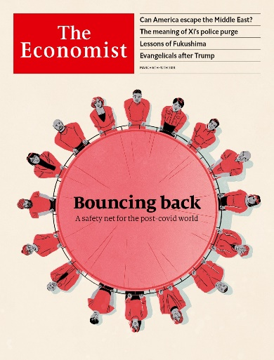
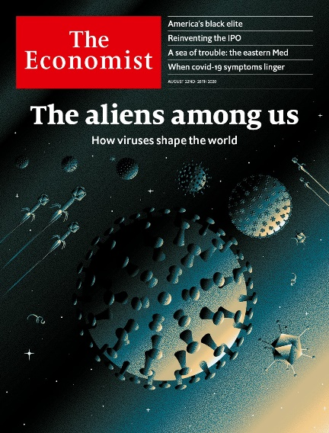
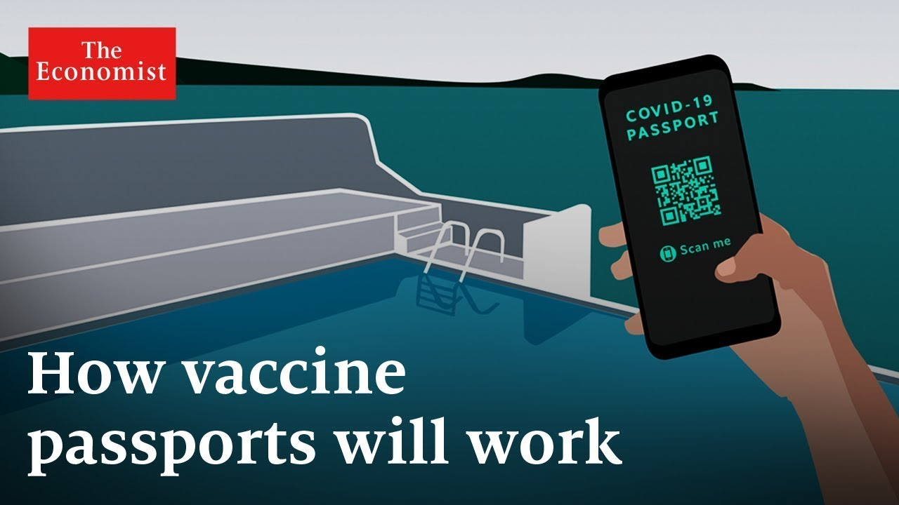
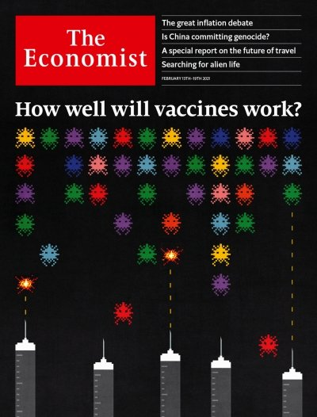
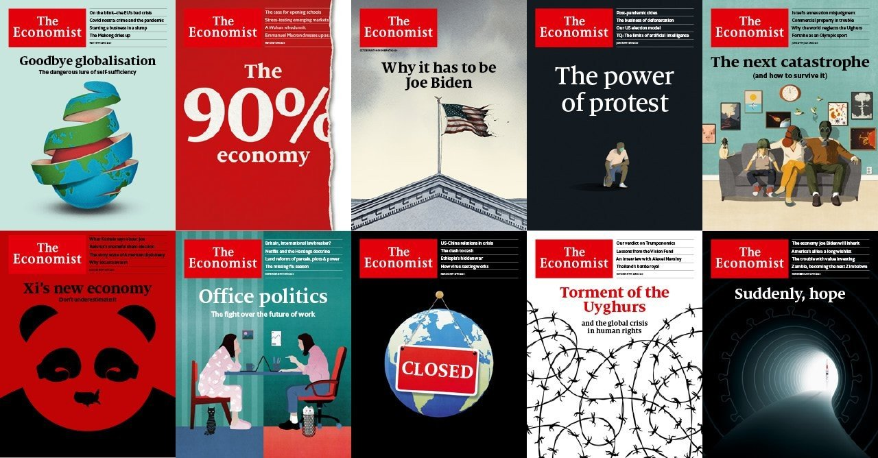
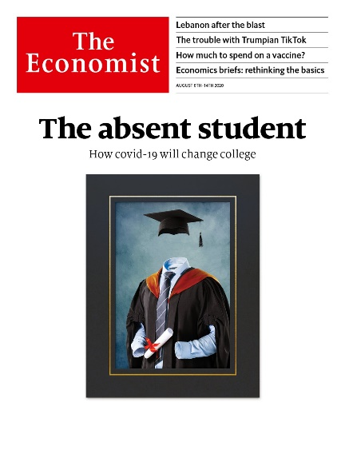

Slide 37
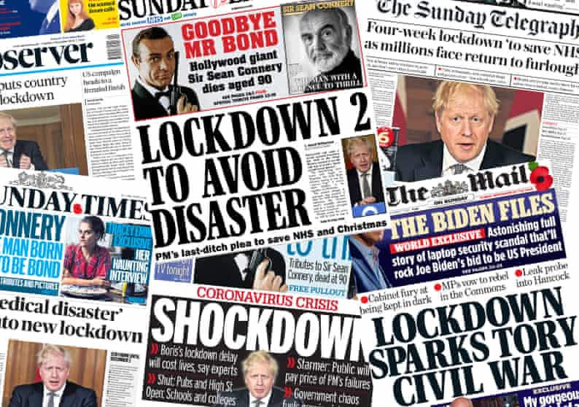

Slide 38
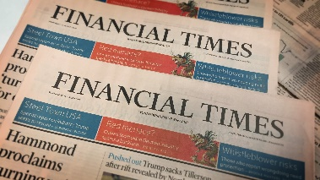
WRITTEN
SPOKEN

Slide 39
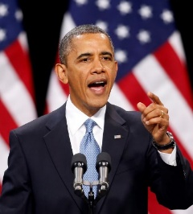
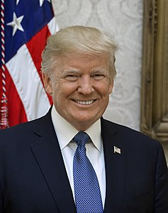
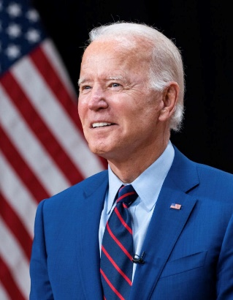
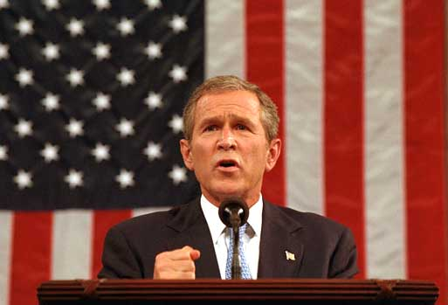
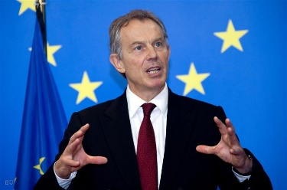
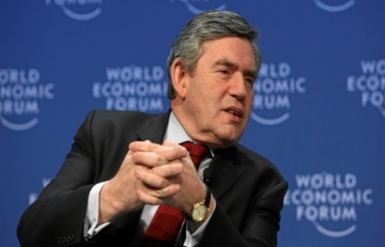
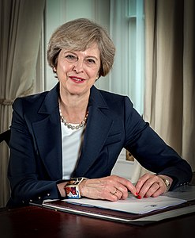
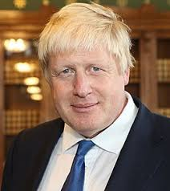
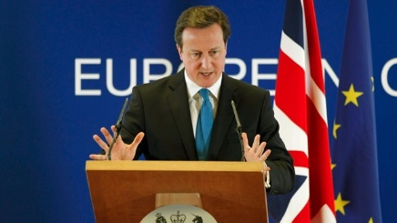
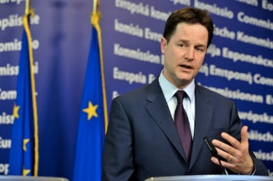
WRITTEN
SPOKEN

Slide 40
WRITTEN
George Bush
Barack Obama
Donald Trump
Joe Biden
Tony Blair
Gordon Brown
Theresa
May
SPOKEN
David Cameron
Nick Clegg
Boris Johnson

Slide 41
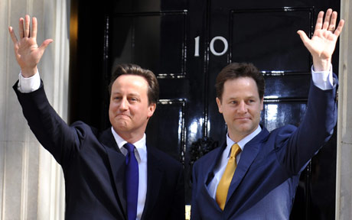
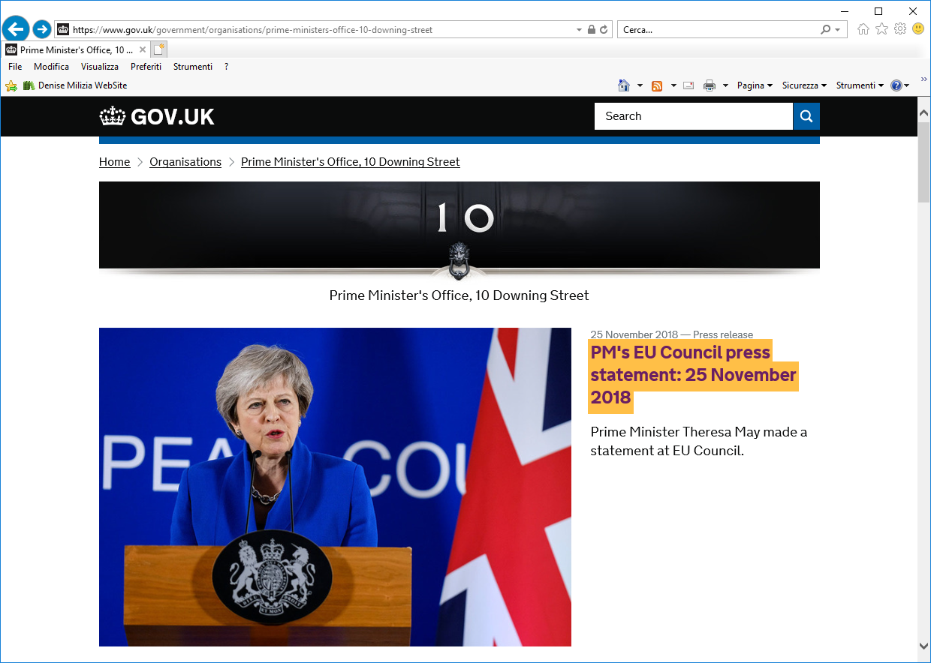
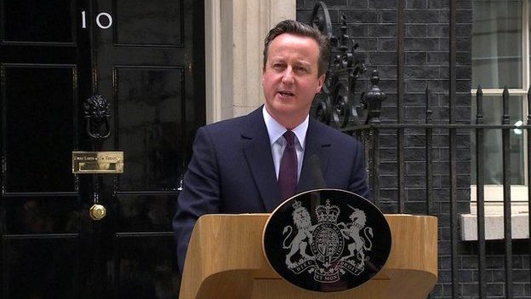
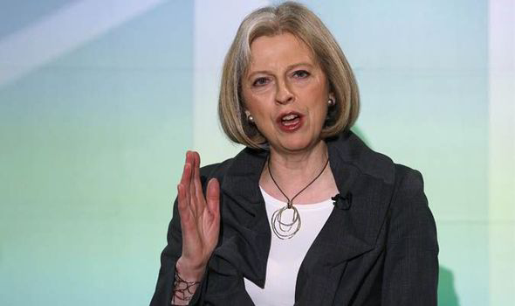
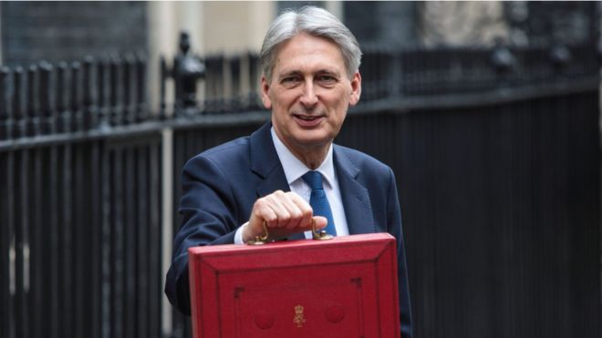
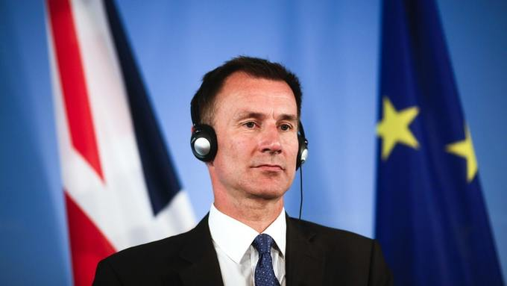
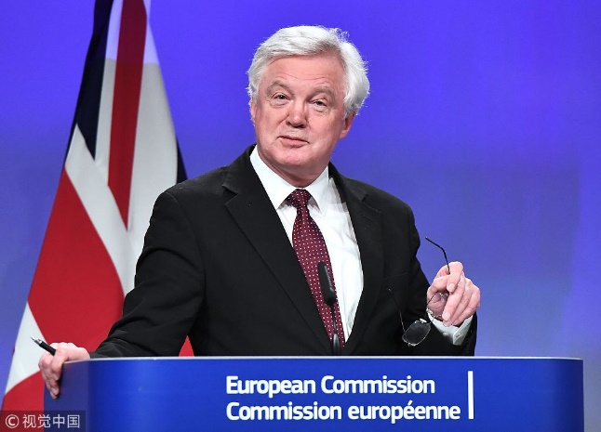
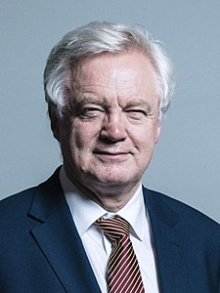
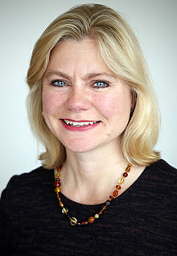
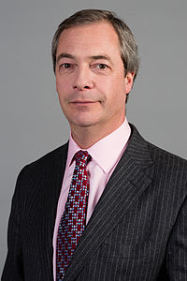
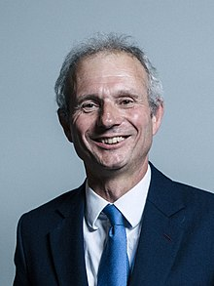
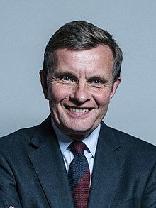

Slide 42
All the speeches delivered by:
George W. Bush (2001-2009)
Barack H. Obama (2009-2016)
Donald Trump (2016-2021)
Joe Biden (2021-today)

Slide 43
All the speeches delivered by:
Tony Blair (1997-2007)
Gordon Brown (2007-2010)
David Cameron & Nick Clegg (2010-2015)
David Cameron (2015 - 2016)
Theresa May (2016 - 2019)
Boris Johnson (2019-today)

Slide 44
All the speeches delivered by:
George W. Bush (2001-2009)
Barack H. Obama (2009-2016)
Donald Trump (2017-2021)
Joe Biden (2021 – ongoing)
All the speeches delivered by:
Tony Blair (1997-2007)
Gordon Brown (2007-2010)
David Cameron & Nick Clegg (2010-2015)
David Cameron (2015 - 2016)
Theresa May (2016 - 2019)
Boris Johnson (2019-today)

Slide 45
SPOKEN
corpus

Slide 46
Twitter is shaping the nature of political discourse in the 21st century.
Social media platforms have become “ubiquitous communication channels”, largely due to the speed and efficiency with which they “allow candidates to directly reach out to voters, mobilize support, and influence the public agenda”.
(Stier et al. 2018)

Slide 47
Tweets were originally restricted to 140 characters of texts, including spaces. As of November 2017, the character limit has been increased to 280.
(Perez 2017)
Tweets serve their purpose because it is much easier to consume
bite-sized than long written statements.
(Olson 2021)

Slide 48
Tweets consisting of text only
Tweets consisting of text and a hyperlink
Tweets containing text and image
Tweets containing image with included link to external content
Tweets containing a GIF
Tweets containing an embedded video
(Wignell et al. 2018)

Slide 49
The twittering presidents
Wignell et al. (2021)

Slide 50
I wouldn’t be here if it wasn’t for Twitter !

Slide 53
Twitter “his own form of media”
(Schwartz 2017)
Much of the mass media is dishonest, fake, and despicable
(Demata 2018)
corrupt, crooked, fraudulent, lame stream.
(Milizia 2021)

Slide 54
@POTUS
@WhiteHouse
@realDonaldTrump

Slide 55
@POTUS
@WhiteHouse
@JoeBiden
@POTUS₄₅
@WhiteHouse
@realDonaldTrump

Slide 61
Do you know these people?

Slide 62
Do you know these people?

Slide 63
Priti Patel
Boris Johnson
Dominic Raab

Slide 64
Priti Patel
Boris Johnson
Dominic Raab
Home Secretary
Prime Minister
Foreign Secretary

Slide 65
Do you know these people?

Slide 66
Nancy Pelosi
Donald Trump
Mike Pence

Slide 67
Nancy Pelosi
Donald Trump
Mike Pence
Speaker of the House of Representatives
former
President of the USA
former
Vice President of the USA

Slide 68
Do you know these people?

Slide 69
Nancy Pelosi
Joe Biden
Kamala Harris
Speaker of the House of Representatives
President of the USA
Vice President of the USA

Slide 70
1.
2.
WRITTEN
SPOKEN

Slide 72
National and international challenges in Europe and beyond:
a linguistic analysis

Slide 73
What, you think, could be a challenge today?
National and international challenges in Europe and beyond:
a linguistic analysis
When you think of the word challenge, what do you think?

Slide 74
What, you think, could be a challenge today?
Brexit
Climate change
borders
Immigration
Ukraine
The pandemic
Vaccines

Slide 75
What, you think, could be a challenge today?

Slide 76
challenge

Slide 78
we can SORT our words:
R1 – the first to the RIGHT
R2 – the second to the RIGHT
R3 – the third to the RIGHT
L1 – the first to the LEFT
L2 – the second to the LEFT
L3 – the third to the LEFT

Slide 79
We remain in the teeth of this pandemic.

Slide 80
challeng*

Slide 81
challenge
challeng*
challenges
challenging
challenged
challenge (v)
challenges (v)

Slide 87
For that reason, the specific measures I am about to set out apply in England only.
First, on retail, shops. This has been the most challenging period for shops and high streets in our history. Never before have all shops been ordered to shut in this way. It has now been 82 days since we asked these shops to close their doors and I know the toll this has taken.
Which is why I am so pleased that we can now allow all shops to reopen from Monday. It is vital that establishments should ensure they are meeting Covid Secure guidelines before they reopen.
That way we can keep staff and customers safe while we get retail going.
Second, on social contact. I know how difficult the past months have been for people cut off from their friends and family.
Last Monday, we relaxed the rules on meeting outdoors so that groups of up to 6 could gather, provided they are socially distant. We did so in the knowledge that transmission of the virus is much lower outdoors, so we could make this change in a safe way.
But there are still too many people, particularly those who live by themselves, who are lonely and struggling with being unable to see friends and family.
From this weekend, we will allow single adult households - so adults living alone or single parents with children under 18 - to form a “support bubble” with one other household.
All those in a “support bubble” will be able to act as if they live in the same household - meaning they can spend time together inside each others’ homes and do not need to stay 2 metres apart.
I want to stress that “support bubble” must be exclusive - meaning you cannot switch the household you are in a bubble with or connect with multiple households. And if any member of the support bubble develops symptoms, all members of the bubble will need to follow the normal advice on household isolation.
We are making this change to support those who are particularly lonely as a result of lockdown measures. It is a targeted intervention to limit the most harmful effects of the current social restrictions. It is emphatically not designed for people who don’t qualify to start meeting inside other people’s homes - that remains against the law.
Unfortunately, we cannot advise anyone who is shielding to form a support bubble at this stage, given their particular vulnerability to the virus. However, I want to say I know how hard it is for those of you who are shielding, and we will say more next week about the arrangements that will be in place for you beyond the end of June.
Third, on outdoor attractions. Because the risk of transmission is lower outdoors, we can open up some more outdoor attractions for people to enjoy this summer.

Slide 91
What is the verb we use with challenge?

Slide 92
What is the verb we use with challenge?
face

Slide 93
…have been working around the clock…

Slide 94
challenge
crisis
threat

Slide 95
Looking at all this data, mainly spoken data, we study:
Politics (present and past)
2. Language: grammar
lexis
phraseology

Slide 96
Looking at all this data, mainly spoken data, we study:
Politics (present and past)
2. Language: grammar passive
lexis
phraseology
How do you form the passive voice?
Which auxiliary verbs do you use?
to be
to get
to become

Slide 97
to be
to get
to become

Slide 98
to be
to get
to become

Slide 100
Looking at all this data, mainly spoken data, we study:
Politics (present and past)
2. Language: grammar passive
lexis
phraseology
vaccine shots

Slide 102
Looking at all this data, mainly spoken data, we study:
Politics (present and past)
2. Language: grammar passive
lexis
phraseology
Phrases and phrasal verbs
so far give up
as it were take off
take it for granted turn out
turn a blind eye on look away

Slide 103
B.A.

Slide 104
M.A.

Slide 106
https://twitter.com/cbsnews/status/1365038516720308228
I want to close with this: The question I ask, I’m asked most often is, “When will things get back to normal?” My answer is always honest and straightforward. I can’t give you a date. I can only promise that we’ll work as hard as we can to make that day come as soon as possible.
While things are improving, and we’re going from a mess we inherited to moving in the right direction, at significant speed, this is not a victory lap. This — everything is not fixed. We have a long way to go. And that day, when everything gets back to normal, depends on all of us. It depends on Congress passing the American Recovery Act — research plan — recovery plan. And also for us to remain vigilant, to look out for one another.
I’ve said it before: Wash your hands. Stay socially distanced. Wear a mask. Get the vaccine when it’s your turn. When your friend or neighbor or loved one is eligible, encourage them to get vaccinated.
And when all — above all, remember: We can do this. This is the United States of America. There is nothing we can’t do when we do it together. So it’s not over yet, but we’re getting close. And God willing, if we do all we know we have to do, we’re going to beat this; beat it sooner than later.
And may God bless you all, and may God protect our troops. Thank you for your time.

Slide 107
https://twitter.com/cbsnews/status/1365038516720308228
I want to close with this: The question I ask, …………….. most often is, “When will things get back to normal?” My answer is always honest and straightforward. I can’t give you a date. I can only promise that we’ll work …………………..to make that day come ………………………...
While things are improving, and we’re going from a mess we inherited to moving in the right direction, at significant speed, this is not a victory lap. This — everything is not fixed. We have a long way to go. And that day, when everything gets back to normal, ……………….. all of us. It ………………………… Congress passing the American Recovery Act — research plan — recovery plan. And also for us to remain vigilant, to …………………….. one another.
I’ve said it before: Wash your hands. Stay socially distanced. Wear a mask. Get the vaccine when it’s your turn. When your friend or neighbor or loved one is eligible, encourage them to ………………………...
And when all — above all, remember: We can do this. This is the United States of America. There is nothing we can’t do when we do it together. So ……………………………., but we’re getting close. And God willing, if we do all we know we have to do, we’re going to beat this; beat it sooner than later.
And may God bless you all, and may God protect our troops. Thank you for your time.

Slide 108
https://twitter.com/cbsnews/status/1365038516720308228
I want to close with this: The question I ask, I’m asked most often is, “When will things get back to normal?” My answer is always honest and straightforward. I can’t give you a date. I can only promise that we’ll work as hard as we can to make that day come as soon as possible.
While things are improving, and we’re going from a mess we inherited to moving in the right direction, at significant speed, this is not a victory lap. This — everything is not fixed. We have a long way to go. And that day, when everything gets back to normal, depends on all of us. It depends on Congress passing the American Recovery Act — research plan — recovery plan. And also for us to remain vigilant, to look out for one another.
I’ve said it before: Wash your hands. Stay socially distanced. Wear a mask. Get the vaccine when it’s your turn. When your friend or neighbor or loved one is eligible, encourage them to get vaccinated.
And when all — above all, remember: We can do this. This is the United States of America. There is nothing we can’t do when we do it together. So it’s not over yet, but we’re getting close. And God willing, if we do all we know we have to do, we’re going to beat this; beat it sooner than later.
And may God bless you all, and may God protect our troops. Thank you for your time.

Slide 109
We study grammar, lexis and
phrases through the
language of politicians.
Examples taken from
real life language use!

Slide 110
How would you translate the following sentences into English?
La domanda che più spesso mi fanno è: quando le cose torneranno alla normalità?
Posso solo promettervi che lavoreremo più che potremo.
C’è ancora tanto da fare.
Il giorno in cui tutto tornerà normale dipende da tutti noi.
L’ho già detto: lavatevi le mani, mantenete le distanze,
indossate la mascherina e andate a vaccinarvi.
Non è ancora finita, ma ci siamo quasi.
E se Dio vuole, e facciamo tutto ciò che sappiamo che dobbiamo fare,
vinceremo tutto ciò, e vinceremo più presto che tardi.

Slide 111
How would you translate the following sentences into English?
The question I’m asked most often is, “When will things get back to normal?”
I can only promise that we’ll work as hard as we can
We have a long way to go.
The day, when everything gets back to normal, depends on all of us.
I’ve said it before: Wash your hands. Stay socially distanced.
Wear a mask. Get the vaccine.
It’s not over yet, but we’re getting close.
And God willing, if we do all we know we have to do,
we’re going to beat this, beat it sooner than later.

Slide 113
Prime Minister's address to the nation on the Russian invasion of Ukraine

Slide 114
Shortly after 4 o’ clock this morning I spoke to President Zelenskyy of Ukraine to offer the continued support of the UK, because our worst fears have now come true, and all our warnings have proved tragically accurate. President Putin of Russia has unleashed war in our European continent. He has attacked a friendly country without any provocation and without any credible excuse.
Innumerable missiles and bombs have been raining down on an entirely innocent population. A vast invasion is underway by land by sea and by air. And this is not in the infamous phrase some faraway country of which we know little. We have Ukrainian friends in this country, neighbours, co-workers. Ukraine is a country that for decades has enjoyed freedom and democracy and the right to choose its own destiny. We – and the world – cannot allow that freedom just to be snuffed out. We cannot and will not just look away.
It’s because we have been so alarmed in recent months at the Russian intimidation that the UK became one of the first countries in Europe to send defensive weaponry to help the Ukrainians.
Other allies have now done the same, and we will do what more we can in the days ahead.
Today in concert with our allies, we will agree a massive package of economic sanctions designed in time to hobble the Russian economy. And, to that end, we must also collectively cease the dependence on Russian oil and gas that for too long has given Putin his grip on western politics.

Slide 115
Our mission is clear. Diplomatically, politically, economically – and eventually, militarily – this hideous and barbaric venture of Vladimir Putin must end in failure. And so, I say to the people of Russia, whose president has just authorized a tidal wave of violence against a fellow Slavic people. The parents of Russian soldiers who will lose their lives. I cannot believe this is being done in your name, or that you really want the pariah status it will bring to the Putin regime, and I say to the Ukrainians in this moment of agony, we are with you, we are praying for you and your families, and we are on your side. And if the months ahead are grim, and the flame of freedom burns low, I know that it will blaze bright again in Ukraine, because for all his bombs and tanks and missiles, I don’t believe that the Russian dictator will ever subdue the national feeling of the Ukrainians and their passionate belief that their country should be free.
And I say to the British people, and all who have heard the threats from Putin against those who stand with Ukraine, we will of course do everything to keep our country safe.
We are joined in our outrage by friends and allies around the world. We will work with them – for however long it takes – to ensure that the sovereignty and independence of Ukraine is restored, because this act of wanton and reckless aggression is an attack not just on Ukraine, it’s an attack on democracy and freedom in Eastern Europe and around the world. This crisis is about the right of a free, sovereign independent European people to choose their own future, and that is a right that the UK will always defend.

Slide 116
Our mission is clear. Diplomatically, politically, economically – and eventually, militarily – this hideous and barbaric venture of Vladimir Putin must end in failure. And so, I say to the people of Russia, whose president has just authorized a tidal wave of violence against a fellow Slavic people. The parents of Russian soldiers who will lose their lives. I cannot believe this is being done in your name, or that you really want the pariah status it will bring to the Putin regime, and I say to the Ukrainians in this moment of agony, we are with you, we are praying for you and your families, and we are on your side. And if the months ahead are grim, and the flame of freedom burns low, I know that it will blaze bright again in Ukraine, because for all his bombs and tanks and missiles, I don’t believe that the Russian dictator will ever subdue the national feeling of the Ukrainians and their passionate belief that their country should be free.
And I say to the British people, and all who have heard the threats from Putin against those who stand with Ukraine, we will of course do everything to keep our country safe.
We are joined in our outrage by friends and allies around the world. We will work with them – for however long it takes – to ensure that the sovereignty and independence of Ukraine is restored, because this act of wanton and reckless aggression is an attack not just on Ukraine, it’s an attack on democracy and freedom in East Europe and around the world. This crisis is about the right of a free, sovereign independent European people to choose their own future, and that is a right that the UK will always defend.

Slide 117
Thanks for listening!
National and international challenges in Europe and beyond
denise.milizia@uniba.it
www.denisemilizia.com

