Slide 1
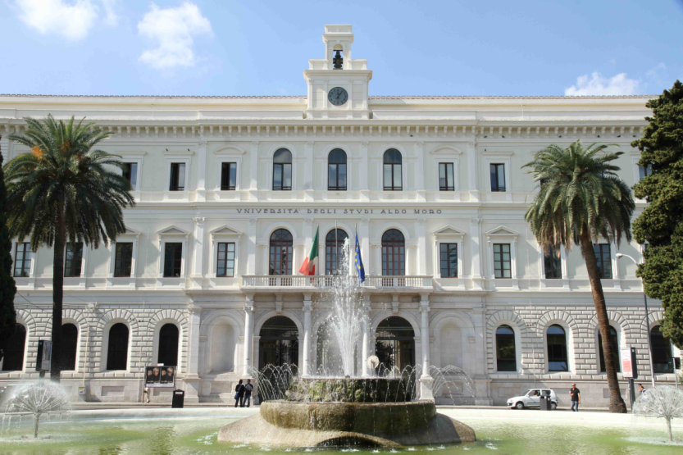
XIX WORKSHOP
ON THE DEVELOPMENTS IN THE ITALIAN
PHD RESEARCH ON FOOD SCIENCE
TECHNOLOGY AND BIOTECHNOLOGY
Bari, September 24th-26th, 2014

