Slide 1
Alternative Representations
December 2, 2019
Louise Wallenberg

Slide 6
Notes:
Je tu il elle

Slide 8
Riddle of the Sphinx (1977)

Slide 9
Dyketactics (Barbara Hammer, 1974)

Slide 10
Looking for Langston (Isaac Julien, 1989) Tongues Untied (Marlon Riggs, 1989)

Slide 11
QUEER
1) adj. strange, odd, eccentric; of questionable character, shady, suspect; out of sorts, giddy or faint (esp. feel -); (sl) homosexual; in Q- street (sl), in debt or trouble or disrepute
2) vt (sl) Put out of order (esp - the pitch for, secretly spoil the chances of)
3) n (sl) a homosexual

Slide 13
Notes:
Anders als die Andern 1919; Vingarne 1916; Madschen in uniform 1932

Slide 16
Shinjuku Boys (Kim Longinotto, 1995)

Slide 17
Venus Boyz (Gabriel Bauer, 2002)

Slide 18
The Aggressives (Daniel Peddle, 2005)

Slide 19
Pier Kids (Elegance Bratton, 2013)

Slide 20
Notes:
Kiki (Sara Jordenö, 2015)

Slide 23
Before We Die (SVT, 2017-2019)
Notes:
Alexej Manvelov

Slide 25
No Sesso Fall/Winter 2019

Slide 27
Slay Model Management

Slide 29
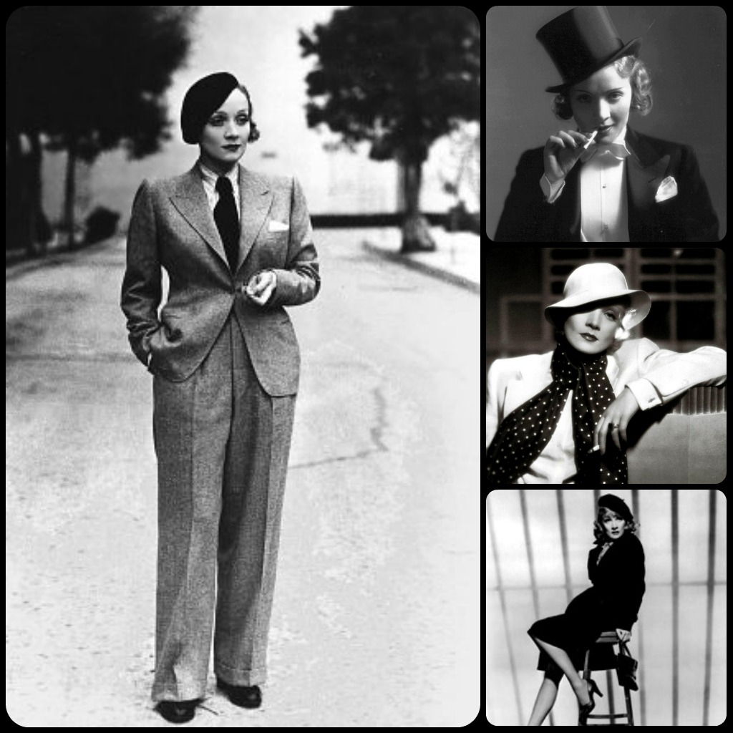

Slide 30
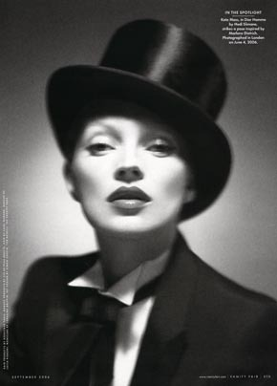

Slide 31
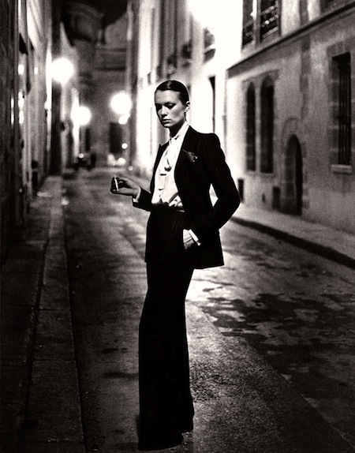

Slide 32
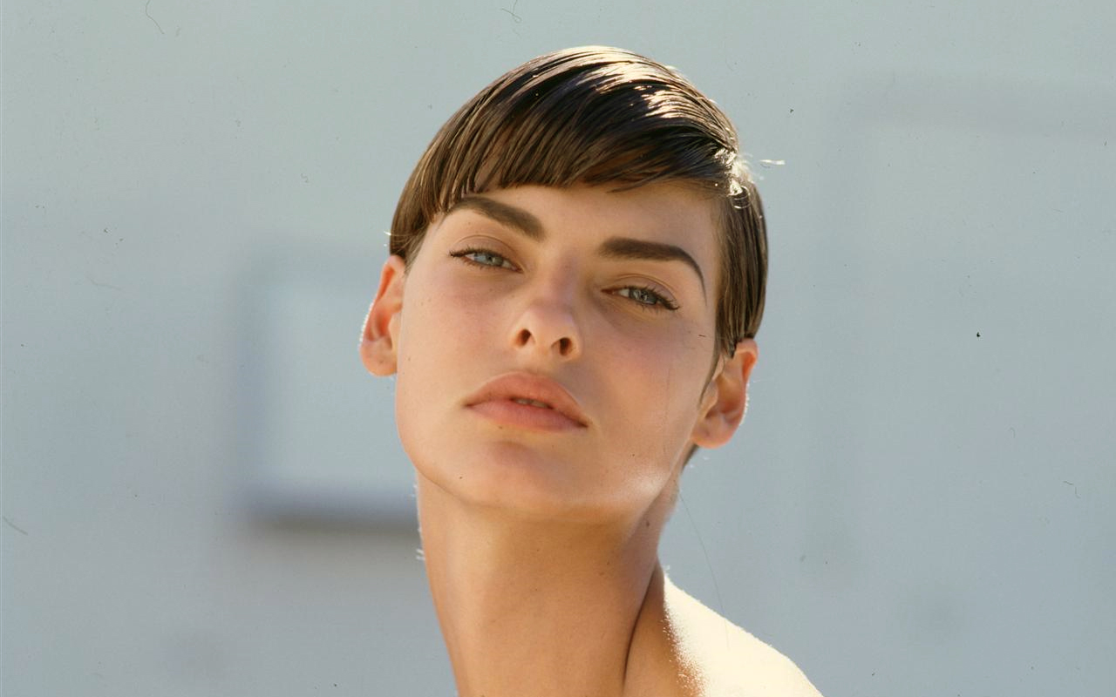
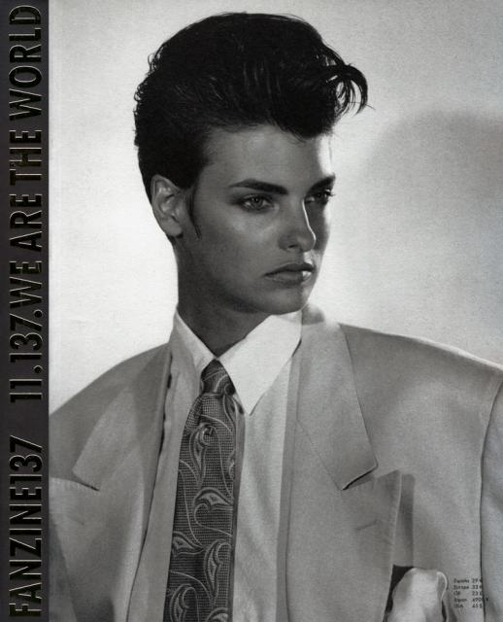
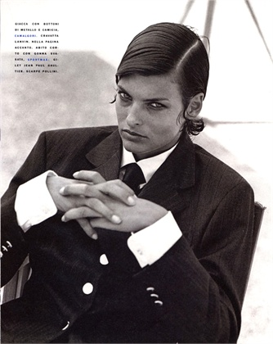

Slide 33
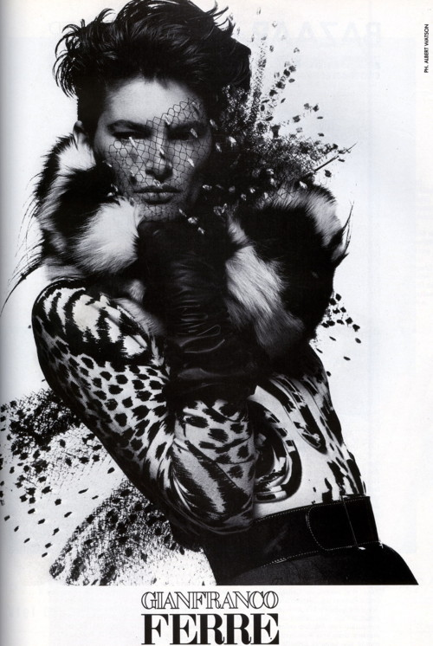
Notes:
Lynn KOester

Slide 34
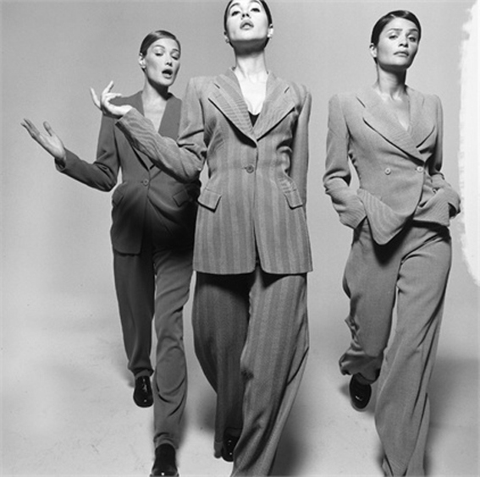

Slide 35
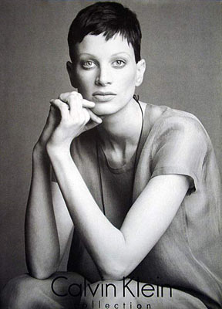

Slide 36
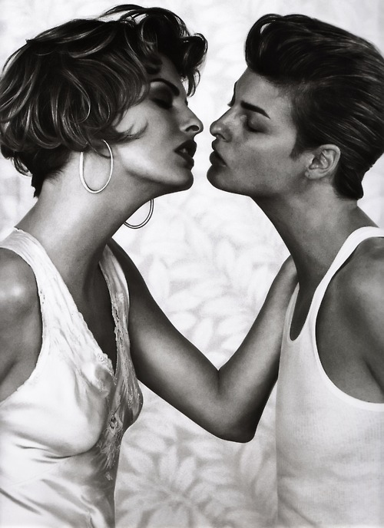

Slide 37
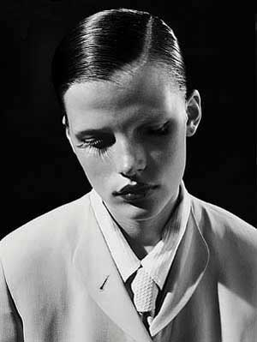
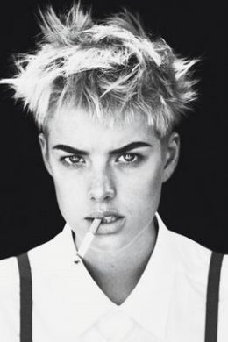

Slide 38
Foucault
You see, if there was no resistance, there would be no power relations. Because it would simply be a matter of obedience. You have to use power relations to refer to the situation where you’re not doing what you want. So, resistance comes first, and resistance remains superior to the forces of the process; power relations are obliged to change with the resistance. So, I think that resistance is the main word, the key word, in this dynamic.

Slide 39
Elizabeth Grosz
“Foucault, in short, has provided a sense of hope, a signal of the possibility, indeed necessity, of a certain agency and efficacy for those classified as oppressed."

